Slide 1
Electrochemistry
Introduction
Electrochemistry is the branch of chemistry which deals with the study of electrical energy into chemical energy or vice-versa.
The device which is used to convert chemical energy into electrical energy is called electrochemical cell.

Slide 2
Types of Electrochemical Cell
Galvanic/Voltaic Cell
Electrolytic Cell
Conversion of chemical energy into electrical energy
e.g.Daniel Cell
Conversion of electrical energy into chemical energy
Electrolysis of H2O

Slide 3
Electrode Potential
The potential difference which generated due to the electrodes present in the cell is called as electrode potential. Electrode potential is of two types oxidation potential and reduction potential.
The tendency of an electrode to lose electrons is called oxidation potential, while tendency to gain electrons is called reduction potential.

Slide 4
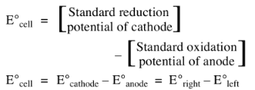
Cell Potential or EMF
EMF of a cell is a measure of the free energy change which determines the tendency of the overall reaction to occur.
If the EMF comes out to be positive, the reaction takes place.

Slide 5
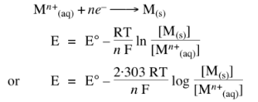
Nernst Equation
Dependence of electrode potential and EMF on concentration and temperature.
For electrode potential;

Slide 6
Gibbs Free Energy Change
Gibbs free energy change in an electrochemical reaction can be expressed as the equivalent of the potential difference.

Slide 7
Electrolysis
The process of decomposition of an electrolyte by the passage of electricity through its aqueous solution or molten state.
Electrodes used in the electrolysis of different electrolytes are of two types, inert electrodes and active electrodes

Slide 8
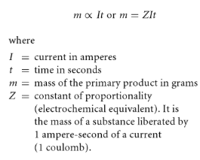
Faraday First Law of Electrolysis
The mass of primary products formed at an electrode by electrolysis is directly proportional to the quantity of electricity passed.

Slide 9
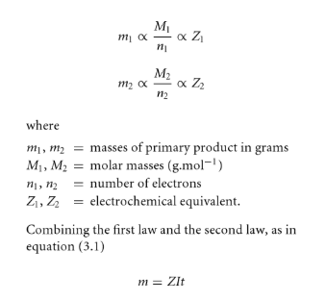
Faraday Second Law of Electrolysis
The masses of different primary products formed by equal amounts of electricity are proportional to the ratio of molar mass to the number of electrons involved with a particular reaction.

Slide 10
Conductance
In relation to electrolytes, the term conductance (C) is used more frequently than resistance. Conductance implies the case with which electric current can flow through a conductor. It is defined as the reciprocal of resistance.

Slide 11
Types of Conductance
Specific Conductance
Specific conductance = Conductance x Cell constant
Equivalent Conductance
Equivalent conductance = (Molar conductance) / n
Where n = (Molecular mass)/(Equivalent mass)
Molar Conductance

Slide 12
Kohlrausch Law
The molar conductivity of an electrolyte at infinite dilution can be expressed as the sum of the ionic conductivities of cations and anions each multiplied by the number of ions present in one formula unit of the electrolyte.

Slide 13
Applications of Kohlrausch Law
1. In the calculation of molar conductivity at infinite dilution for a weak electrolyte
2. In the calculation of the degree of dissociation.

Slide 14
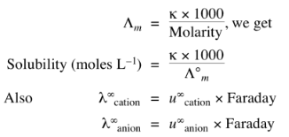
Applications of Kohlrausch Law
3. In the calculation of solubility of a sparingly soluble salt. As the solution is saturated but infinitely dilute.
Molarity = solubility
Hence,

Slide 15
Applications of Kohlrausch Law
Where ‘u’ are ionic mobilities at infinite dilution.
Electrochemistry is the study of chemical processes which lead to electrons moving. This movement of electrons is called electricity, which can be generated in a reaction known as an oxidation-reduction reaction by electrons from one element to another.
THE END

